Slide 1
Understanding Storage Architectures
EUGENE TAN
2016-11-6

Slide 2
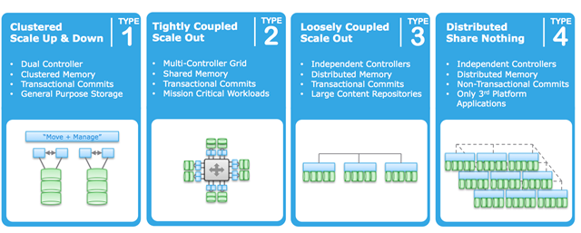
Storage Architectures
Persistence (things that store data, do stuff with information in ANY form) can be grouped into 4 architectural buckets

Slide 3
Storage Architectures
Type 1: Clustered Scale Up & Down Architectures
This is a traditional-style dual controller arrays. Scale by adding disks. Think: EMC VNX, NetApp, Pure , Nimble, Compellent, IBM DS8000
Type 2: Tightly coupled, scale out architectures
This is a new modern shared-nothing architecture. Scale by adding nodes, each with processing and storage. Think: EMC Isilon, Nutanix, ScaleIO, IBM XIV, VMware VSAN
Type 3: Loosely coupled, scale out architectures
This is an older architecture model, but is in use by a couple of younger platforms as well. Scale around is a scale-out architecture that is purposely limited to a finite maximum. Scale is primarily an availability operation instead of a performance one. Scale by adding disks & nodes. Think: EMC VMAX, HP 3Par, HDS VSP
Type 4: Distributed, shared nothing architectures
This is a defined by using NO shared memory between nodes, and the data itself is distributed across some number nodes – but in a lazy, non-transactional way. EMC, AWS, OpenStack

Slide 4
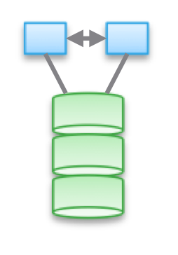
Type 1: Clustered Scale Up & Down Architectures
The basic make-up is two controllers
active/active (both controller serving the same data)
active/standby (one controller serving all the data)
active/passive configuration which is sometimes called asymmetric active/active (both controllers serving different subsets of the data)

Slide 5
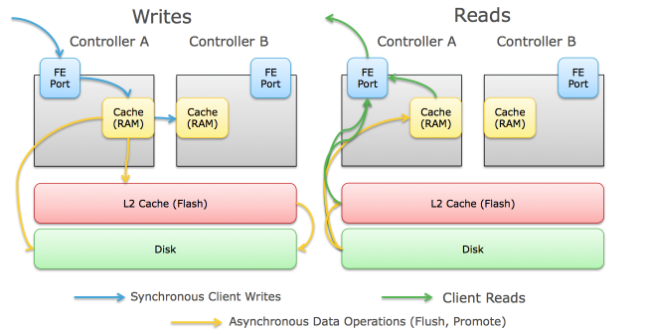
Type 1: Clustered Scale Up & Down Architectures
Client IO Path (Write)
Client initiates the IO and transmits it across the network (SAN or IP SAN) to the next hop
The IO flows through all the switch hops and lands on the front end port of one of the controllers actively serving IO.
The controller receives that IO and caches it into memory (generally RAM, sometimes NVRAM, sometimes SSD).
For data protection purposes, the controller also transmits the IO across an inter-controller link (usually PCIe bus, Infiniband, or other ultra low-latency link) to the other controller which caches the IO into its memory as well, and acknowledges that write back to the first controller
Once the controller receives the write acknowledgement from the second controller, it responds back to the client acknowledging the write
Depending on the array platform, other things can be done with the write like inline deduplication, compression,etc.
Some arrays that implement flash-based write caching can stage the writes to flash to clear the RAM for more incoming writes
The write is eventually flushed to disk (SSD or Magnetic)

Slide 6
Type 1: Clustered Scale Up & Down Architectures
Client IO Path (Read)
Client initiates the IO request and transmits it across the network (SAN or IP SAN) to the next hop
The request flows through all the switch hops and lands on the front end port of one of the controllers actively serving IO
The controller receives the IO request, checks its read cache in RAM for the data and then (depending on the array) checks SSD cache for the data
If the data isn't in either location, it's a "read miss" and the data is read directly from the underlying disks (flash or magnetic)
The controller places a copy of the read in cache (if it was a "read miss") and responds to the client with the requested data

Slide 7
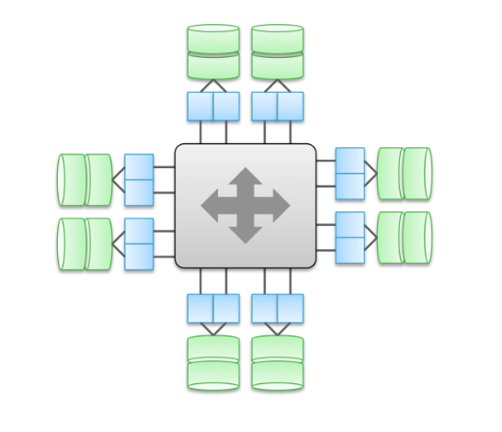
Type 2: Tightly coupled, scale out architectures
These are defined by using shared memory (think cache and some types of metadata) between nodes, and the data itself is distributed across some number nodes.
This architectural model needs to deal with VERY large amount of inter-node communication on for all sorts of operations.
The defining element of shared memory models is critical to these designs. Historically, it enabled “symmetric” IO paths through all brains (the lower diagram). It was originally designed so that in failure (planned or unplanned) modes, IO operations would remain relatively balanced. This was the “origin story” of things like Symmetrix, IBM DS, HDS USP and VSP. They share their cache in some form – so that an IO can be serviced from any brain.

Slide 8
Type 2: Tightly coupled, scale out architectures
Client IO Path (Write)
The two controllers displayed can be two of many more controllers (up to 16 on the VMAX).
Inter-controller communications in Type 2b can actually bypass the CPU of the remote controller for higher performance.
The Flow of write IOs through a scale around array can vary somewhat, but as an example IO through a VMAX generally goes like this:
Client initiates the IO and transmits it across the network (SAN or IP SAN) to the next hop.
The IO flows through all the switch hops and lands on the front end port of one of the controllers.
The controller receives that IO and caches it into global memory in two locations on two different controllers. It access the memory locations directly via the inter-controller link (RapidIO).
Once the controller confirms both writes have been made, it responds back to the client acknowledging the write.
The write is eventually flushed to disk (SSD or Magnetic).

Slide 9
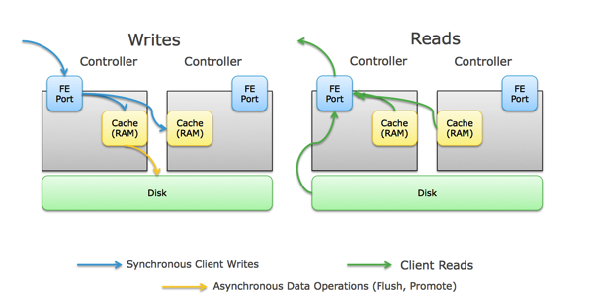
Type 2: Tightly coupled, scale out architectures
Client IO Path (Read)
Client initiates the IO request and transmits it across the network (SAN or IP SAN) to the next hop.
The request flows through all the switch hops and lands on the front end port of one of the controllers.
The controller receives the IO request, checks global memory for the location of the data. If it exists in RAM, it will access the memory location directly via the inter-controller link (RapidIO) no matter which controller physically contains the data.
If the data isn't in global memory, it's a "read miss" and the data is read directly from the underlying disks (flash or magnetic).
The controller places a copy of the read in cache (if it was a "read miss") and responds to the client with the requested data

Slide 10
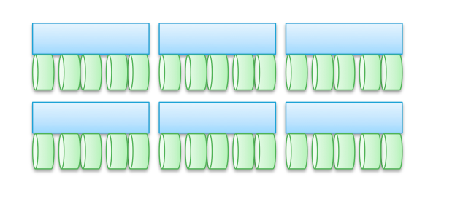
Type 3: Loosely coupled, scale out architectures.
Architecturally, this sounds like the most simple, but is by far the most complicated. The basic make-up varies much more with type 2a systems- it can be packaged as a complete storage array like Isilon, a software-only offering like VMware VSAN and EMC ScaleIO, or an all-in-one storage & compute offering like SimpliVity or Nutanix.

Slide 11
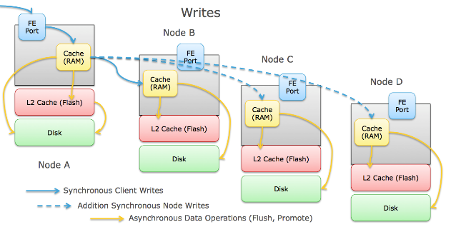
Type 3: Loosely coupled, scale out architectures.
Client IO Path (Write)
The client initiate an IO and transmits it to the node it's communicating with. For all-in-one style architectures, this is a VM node that's co-located with the client on the same hardware.
The node receives that IO and caches it into memory (generally RAM, sometimes SSD).
For data protection purposes, the node also transmits the IO across an inter-node link (usually Ethernet, sometimes Infiniband) to the other node(s) which caches the IO into its memory as well, and acknowledges that write back to the first node. Depending on the architecture, this could be one other node, or every node in the cluster. Also depending on the architecture and protection scheme, the node may break the write up into smaller pieces before distributing them to the other nodes.
Once the node receives the write acknowledgement from the other node(s), it responds back to the client acknowledging the write.
Depending on the array platform, other things can be done with the write like inline deduplication, compression,etc.
Some arrays that implement flash-based write caching can stage the writes to flash to clear the RAM for more incoming writes.
The write is eventually flushed to disk (SSD or Magnetic) on each node that received the write.

Slide 12
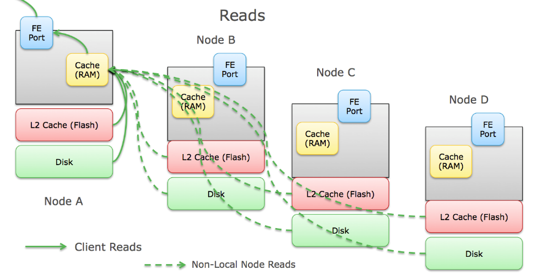
Type 3: Loosely coupled, scale out architectures.
Client IO Path (Read)
The client initiates an IO request and transmits it to the node its communicating with. For all-in-one style architectures, this is a VM node that's co-located with the client on the same hardware.
The node receives that IO, checks its read cache in RAM for the data and then (depending on the array) checks SSD cache for the data.
If the data isn't in either location, it's a " read miss" and the node checks its metadata table to see where the data resides on disk (local or another node or nodes). Data is read directly from the underlying disks if it's local or it is requested from containing node across the inter-node link, and wait for that data to return.
The node places a copy of the read in cache (if it was a "read miss") and responds to the client with the requested data.

Slide 13
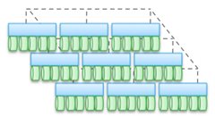
Type 4: Distributed, shared nothing architectures
These architectures chunk up the data and it lives on one node and then periodically (sometimes) distributed copies for protection.
The distribution of data can be forced sometimes, or lazy at others. The “correctness” isn’t necessarily true universally (but often the app stack above checks to make sure it’s using the right data. In the case of some workloads (like HDFS) the data is chunked and distributed to be co-resident with the portion of compute that needs that particular data.
This is actually the property that makes this type of architecture the most scalable of all four.

Slide 14
Type 4: Distributed, shared nothing architectures
They are super-simple. They are crazy easy to manage and operate at scale. They have absolutely no hardware dependencies – so can be on the lowest cost hardware possible, and are almost always software-only.
You can layer or “front” these architectures with block and NAS transactional presentation models, but that only waters down what they are awesome at.
When you have an application that can work around the limits, you can exploit the super-powers of this “Type 4” architecture.

Slide 15
Object Storage versus Block Storage
What is object storage?
What problems does object storage solve?
What about the tradeoffs?
Workloads for object versus block storage
Object storage in practice

Slide 16
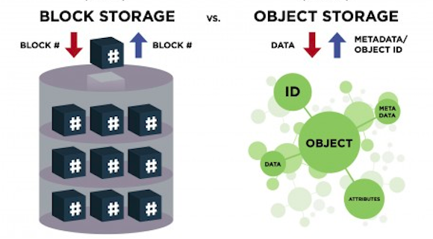
What is object storage?
Object storage (also referred to as object-based storage) is a general term that refers to the way in which we organize and work with units of storage, called objects
Can be anything, metadata with the data, globally access

Slide 17
What problems does object storage solve?
Object storage is ideal for solving the increasing problems of data growth.
As more and more data is generated, storage systems have to grow at the same pace

Slide 18
What about the tradeoffs?
Object storage systems are eventually consistent
block storage systems are strongly consistent

Slide 19
Workloads for object versus block storage
Object storage works very well for unstructured data sets where data is generally read but not written-to
block storage use cases are structured database storage, random read/write loads, and virtual machine file system (VMFS) volumes.
The further the block storage gets from the application, the more the performance suffers due to latency issues.

Slide 20
Object storage in practice
Companies like Amazon (with S3) provide object storage via its public cloud platform at massive scale,
while object storage can be implemented in the company data center using technology like OpenStack’s Swift or EMC’s Atmos.

